Slide 1
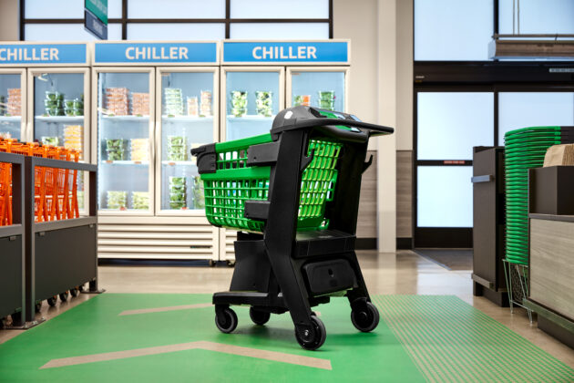

AUTOCART2021™
Guillaume capitan / final pitch 2021

Slide 2


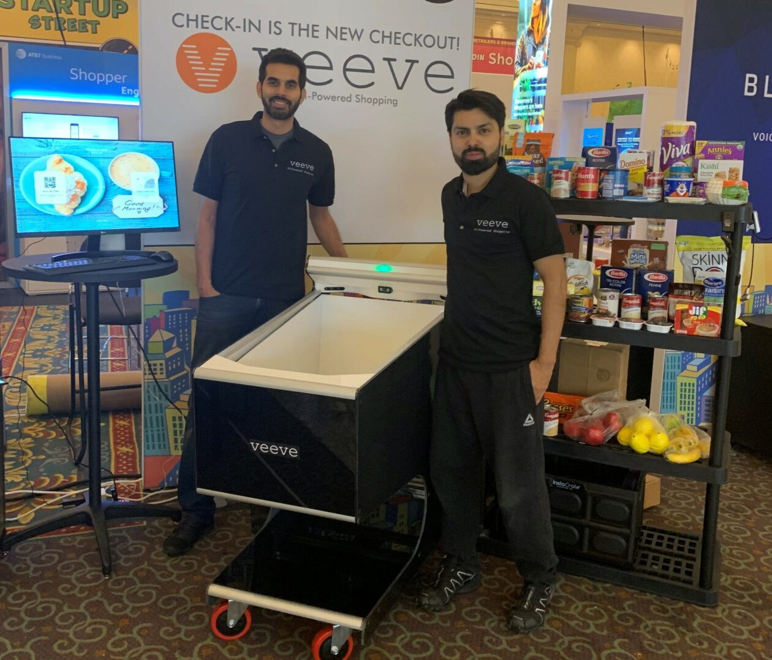



An inclusivity challenge, a tech dare

Slide 3

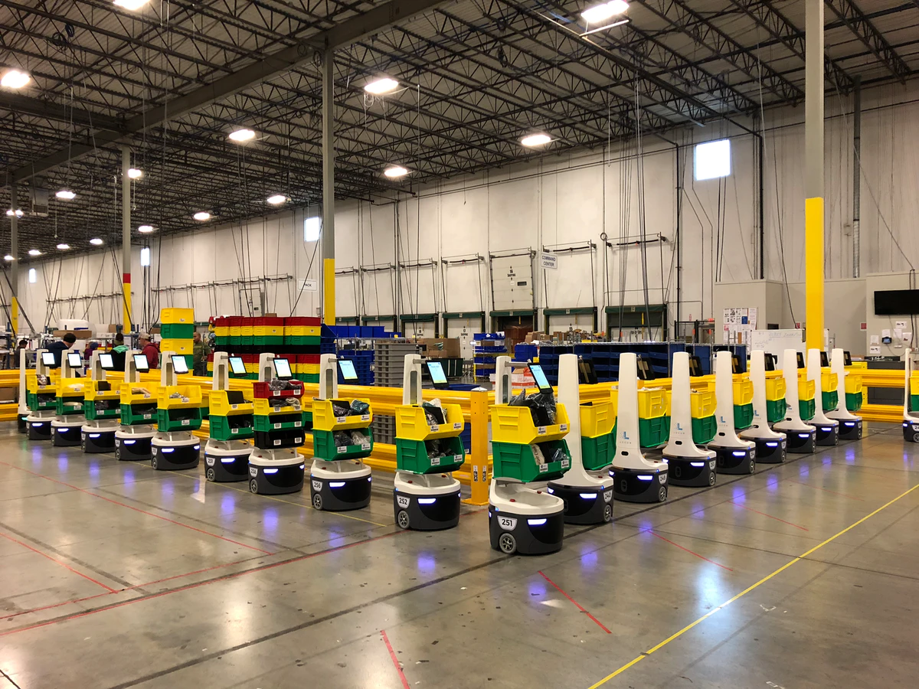
The age-old tradition vs modernity dilemma
We want to help them, making their lives easier
They feel like we are replacing them, making them useless
They need our help to win back autonomy
It’s hard to help them when they’re cut off technology
It DOES seem like a dead end…
…but IS IT ?
Hey, Vsauce, Michael here

Slide 4
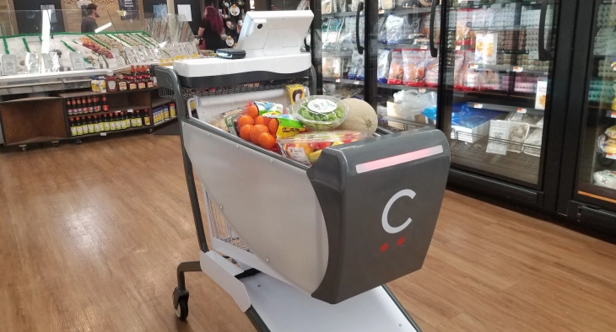
A little teaser to the autocart2021…
9/10 Grandmas recommend this shopping cart
5 Stars – Gramps :
I’ve never felt a shopping experience this good before !
100% Would drift again

Slide 5
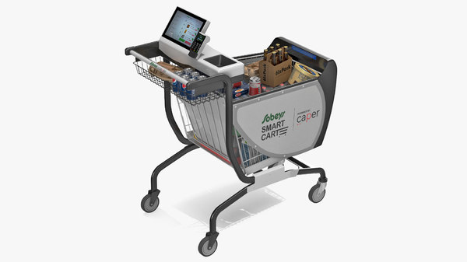
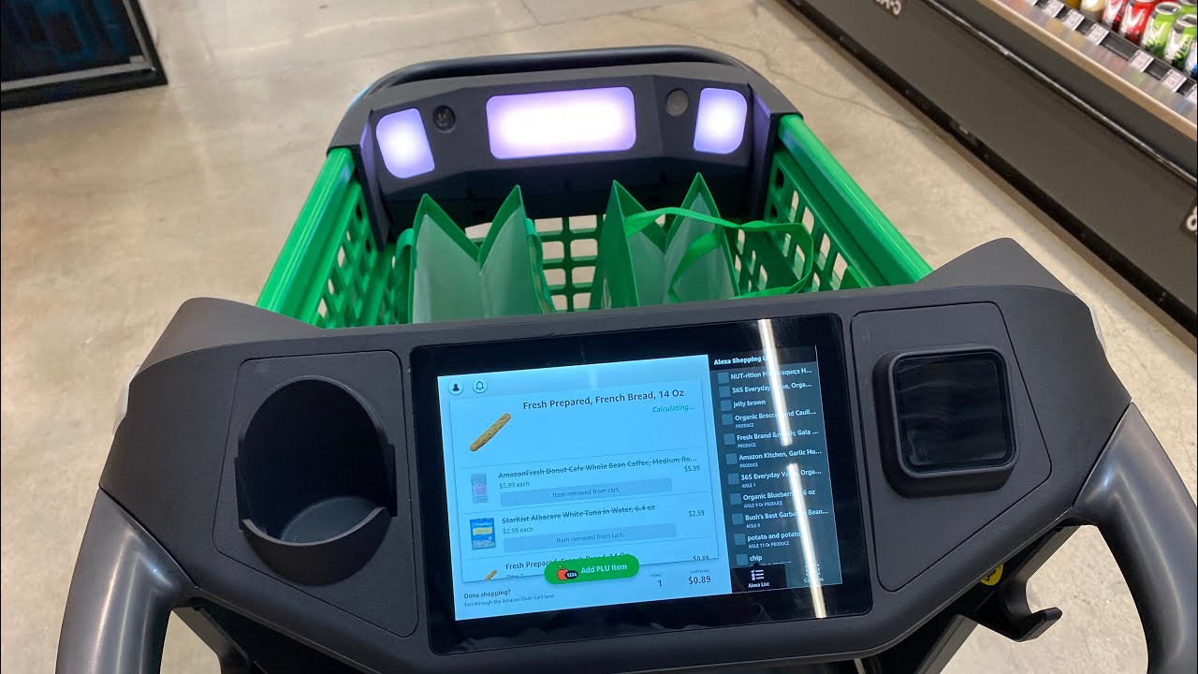
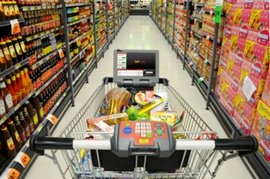
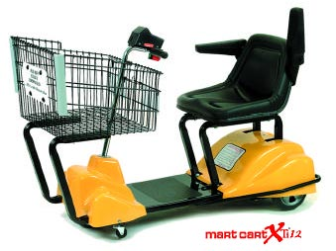
various solutions that could also work (but they’re not mine soooooo not a big deal)
EasyShopping2020 by K. Ronenburg
GoGoBoomer2019 by E. Lonmusk
GoldenShoppingExperience2018 by K. Arim-Benzema
DreamCart2017 by W. Allis & F. Utuna

Slide 6
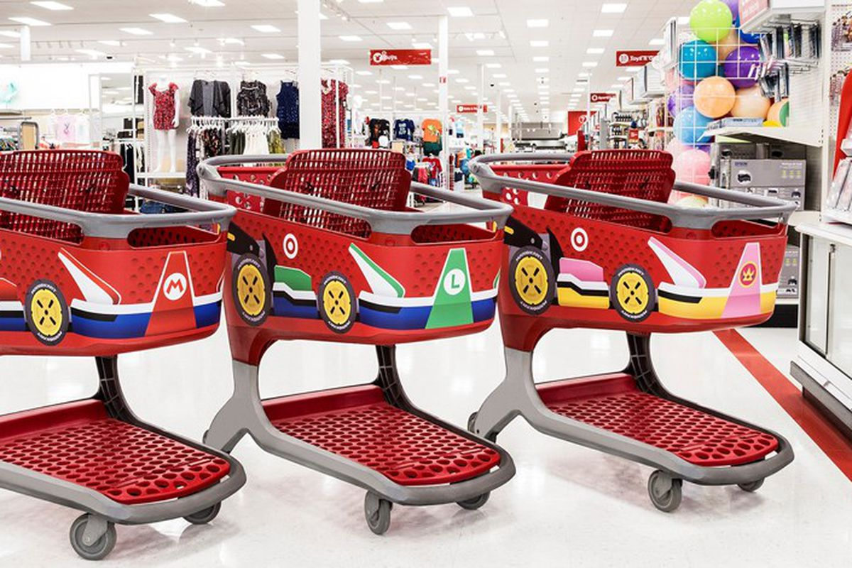
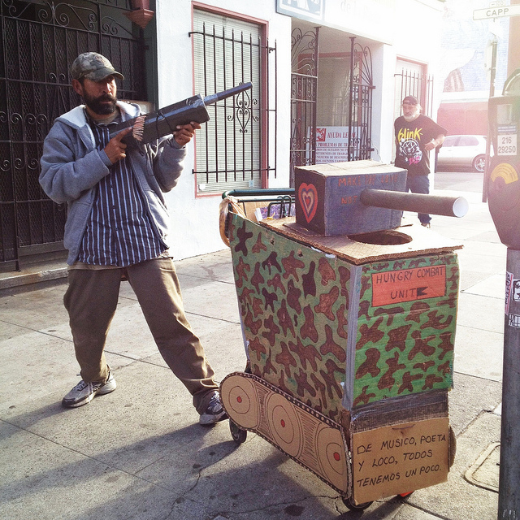
two examples of failed projects : Elderly kart double dash & Deathsteed91
Andrew is just too creative, be kind to him

Slide 7
The real deal : AUTOcart2021™
9/10 Grandmas recommend this shopping cart
5 Stars – Gramps :
I’ve never felt a shopping experience this good before !
100% Would drift again

Slide 8
In short - Inclusivity was our keyword
Impaired ? Here is a custom-made version of the AUTOCART2021™ just for you, with a seat inspired of the magnificent elderly kart double dash project.
Not familiar with technology ? Just pick the simplest version of AUTOCART2021™.
Want help in writing your shopping list ?
In reminding you of the groceries you always forget to buy ?
In pushing that extremely heavy cart ?
There is an AUTOCART2021™ for each one of you. There is an AUTOCART2021™ in each one of us.

Slide 9




LAST BUT NOT LEAST
0 COLTAN
Old people helped develop this project as well ! Isn’t that amazing ?
Impaired workers
0 Carbon (Leroy-Somer IMfinity async motors with recycled materials)
Totally free thanks to our sponsors :
I will put the links in the description of the video

Slide 10
THANKS everyone for your attention, have a great day ☺
Have I answered all your questions ?

